Slide 1

ECE 520 FINAL PROJECT
Alexis Chavez
5/13/2022
PMOD: CONTROL AN LED

Slide 2
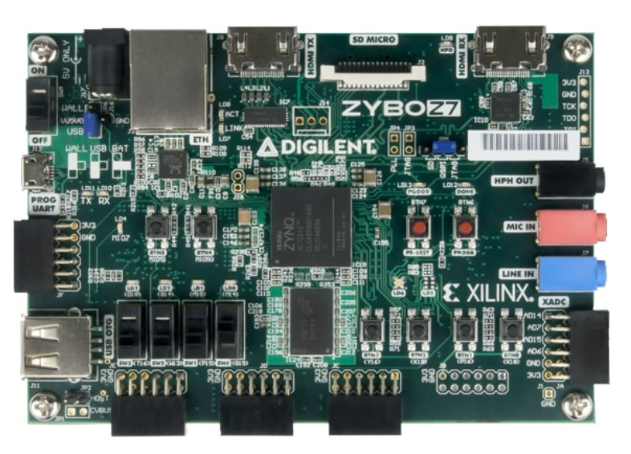
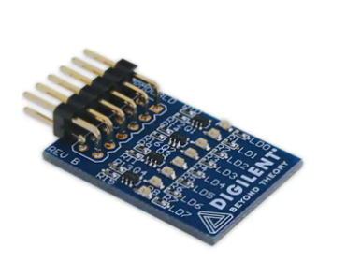
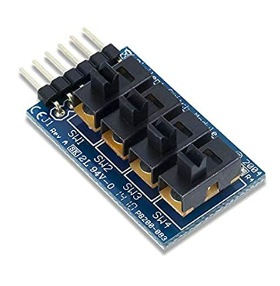
Components
Digilent Zybo Z7-10-SoC Development
8LED and SWT PMOD

Slide 3
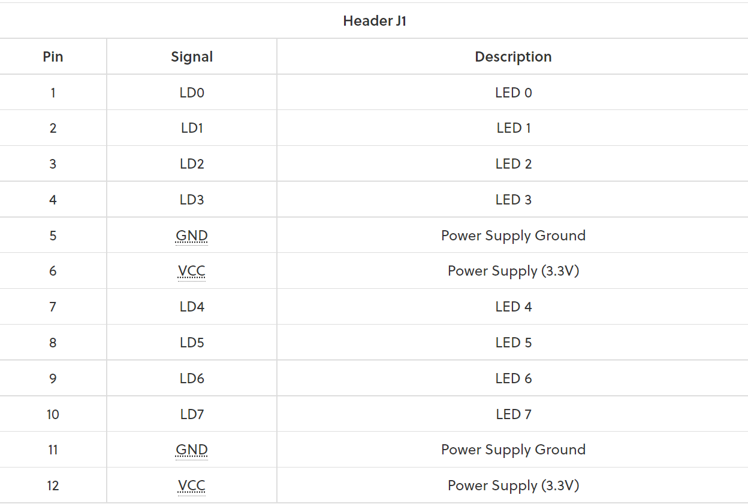
PMOD 8LD
PMOD 8LD utilizes individual transistors so that each be turned on or off independently
To activate an LED the associated pin on the pin header must receive an 1mA of current
Communicates with boards with GPIO pins
Pins become active when they receive a logic High state to be turned on and a Low state to be turned off

Slide 4
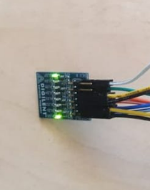
Objective?
Light up the LEDS from the 8LED PMOD
Creating IP package in Vitis HLS
Using the IP package in Vivado
Using Verilog to connect the LED

Slide 5
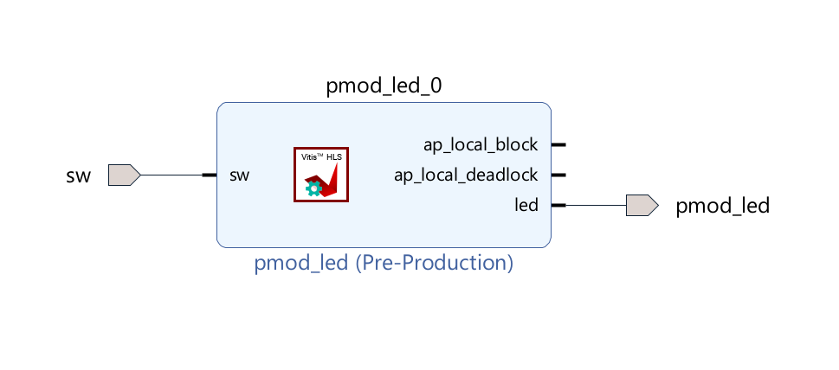
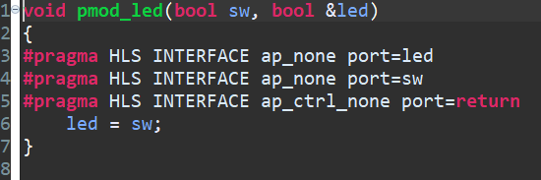
IP Package
Creating the ports

Slide 6
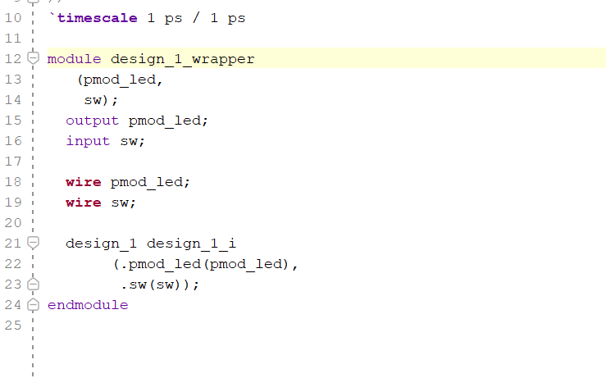
Block Design
Verilog code

Slide 7
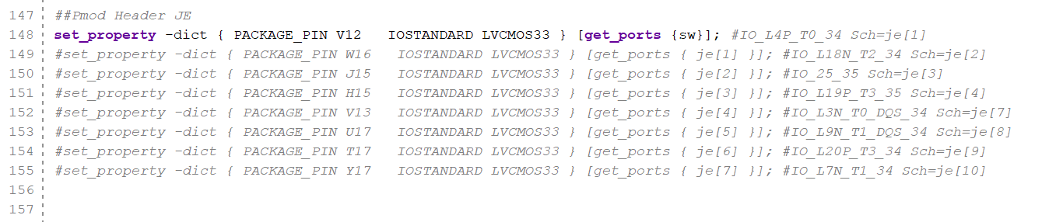
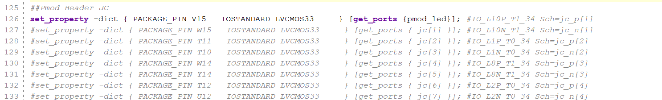
Constraint
Programing the LED

Slide 8
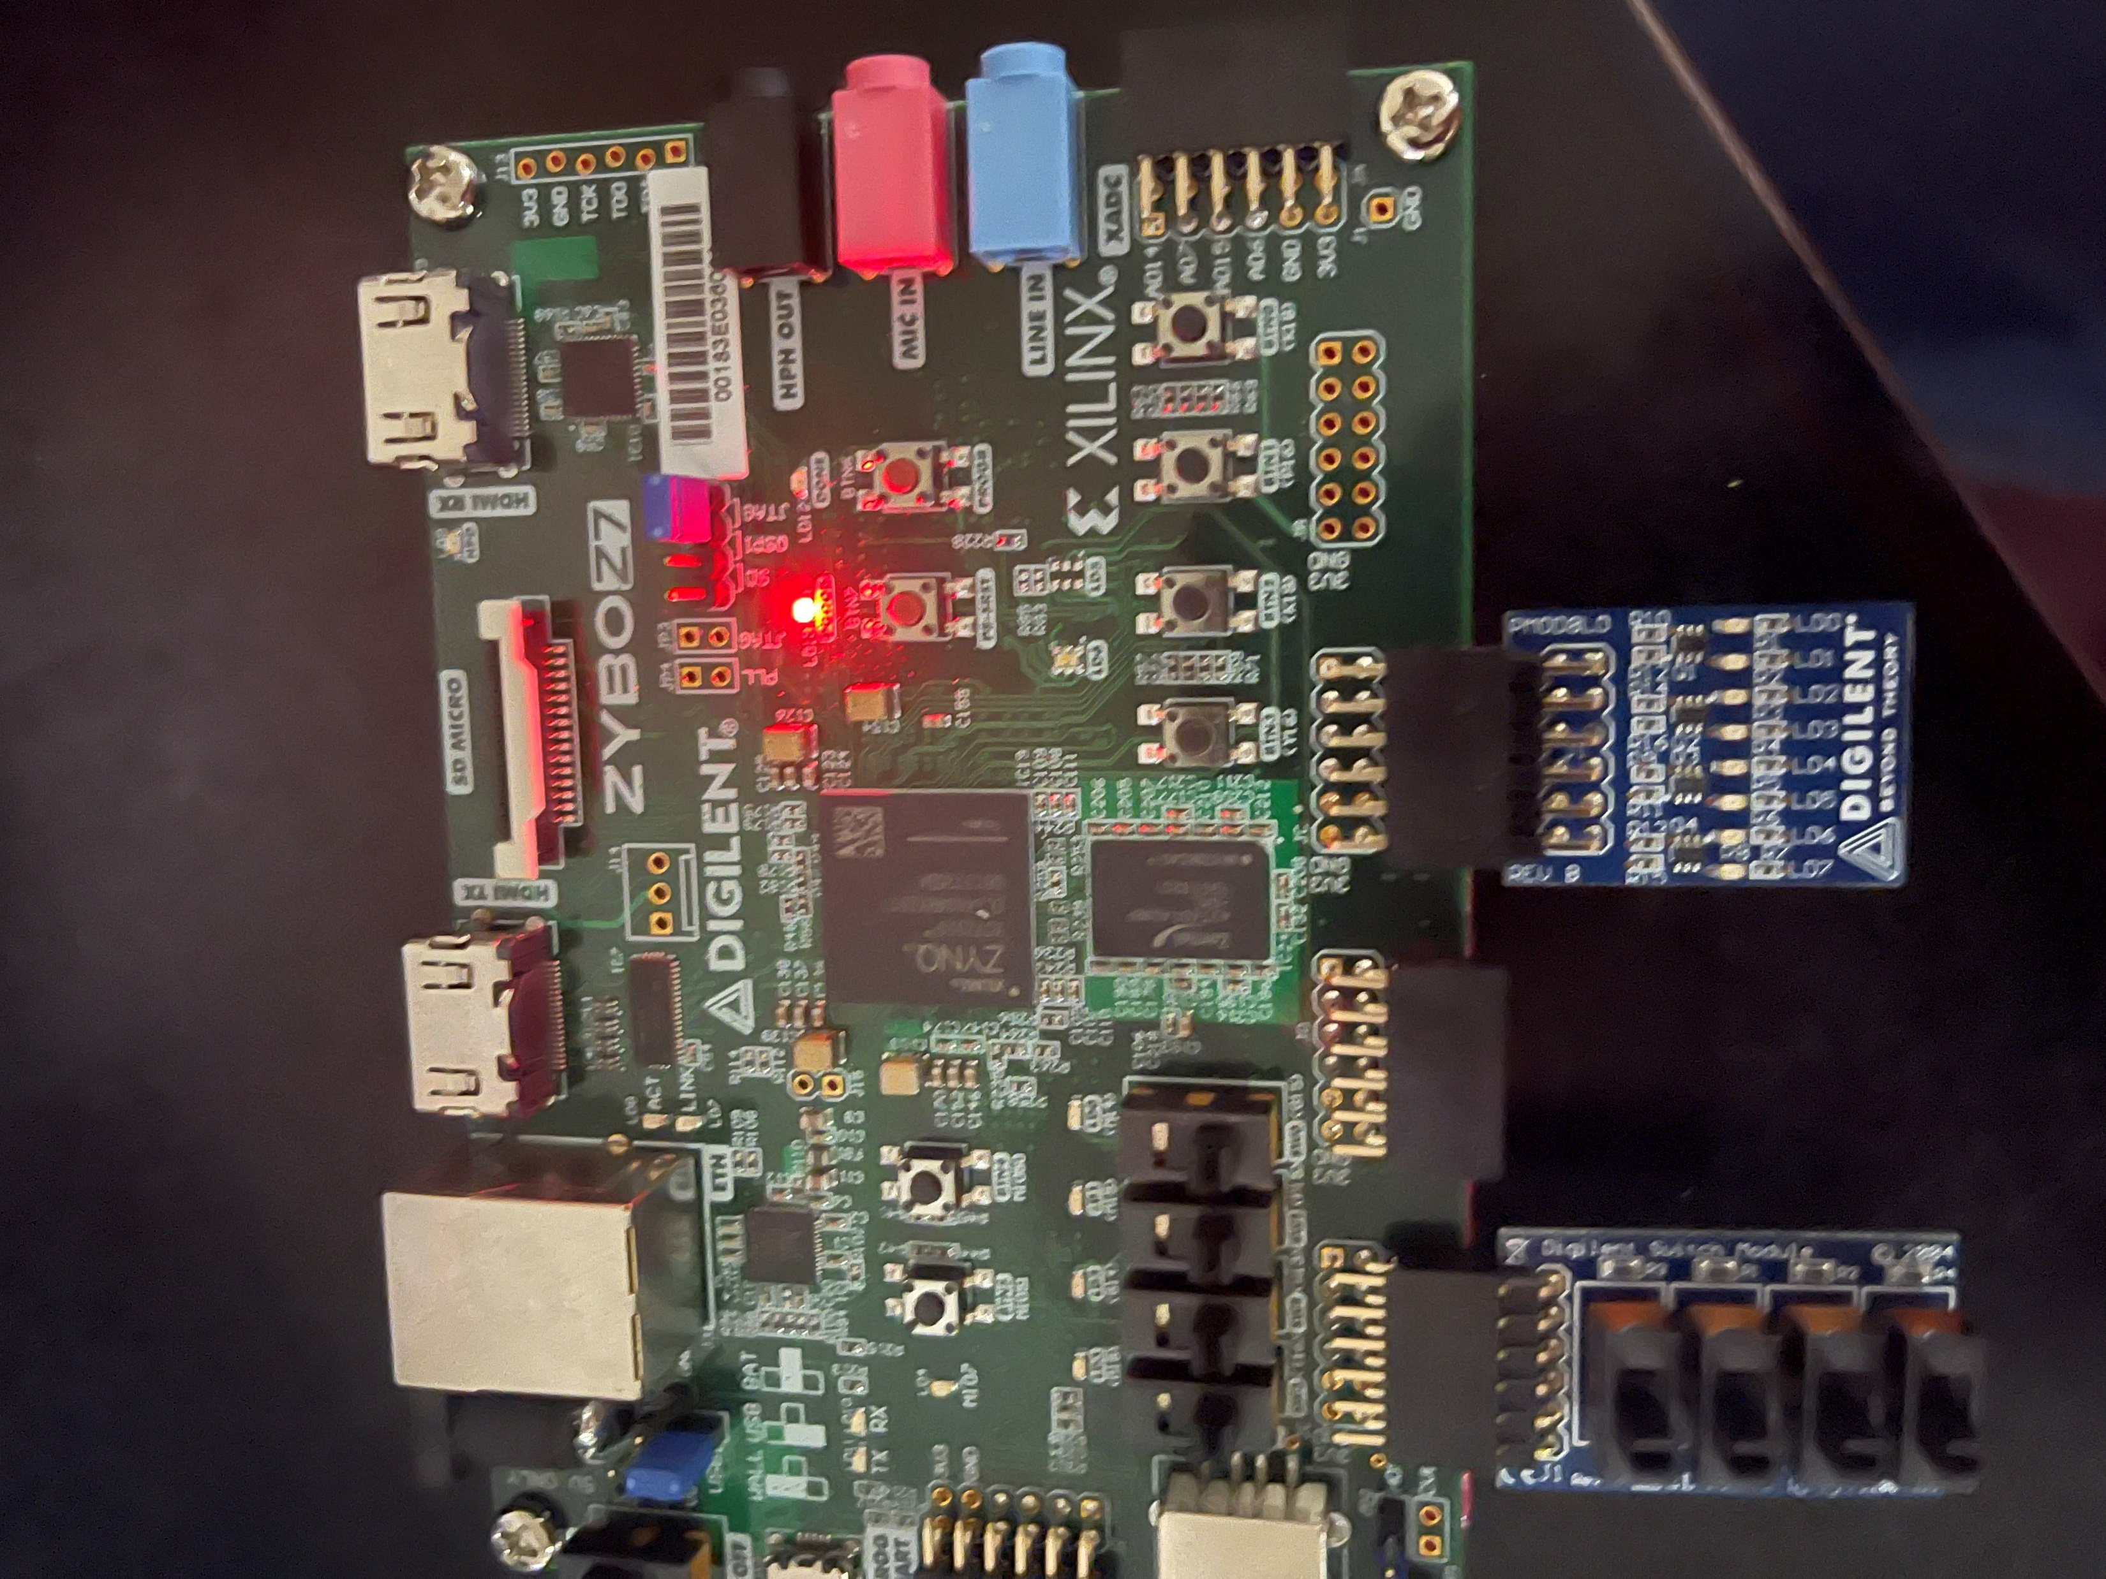
Setup

Slide 9

Demo

